Slide 1
ISP Management System Documentation
DSA Lab Final Project

Slide 2
Table of Contents
1. Introduction
2. Function Overview
Admin menu
User menu
3. Detailed Function Descriptions
4. Data Structures
5. Algorithms
Dijkstra
Prims
6.Conclusion

Slide 3
Introduction
Internet Service Provider System implemented using Graphs, Queues, vectors and AVL.
Functions for administrators and users
By providing separate menus for administrators and users, the system ensures a user-friendly interface and robust functionality.

Slide 4
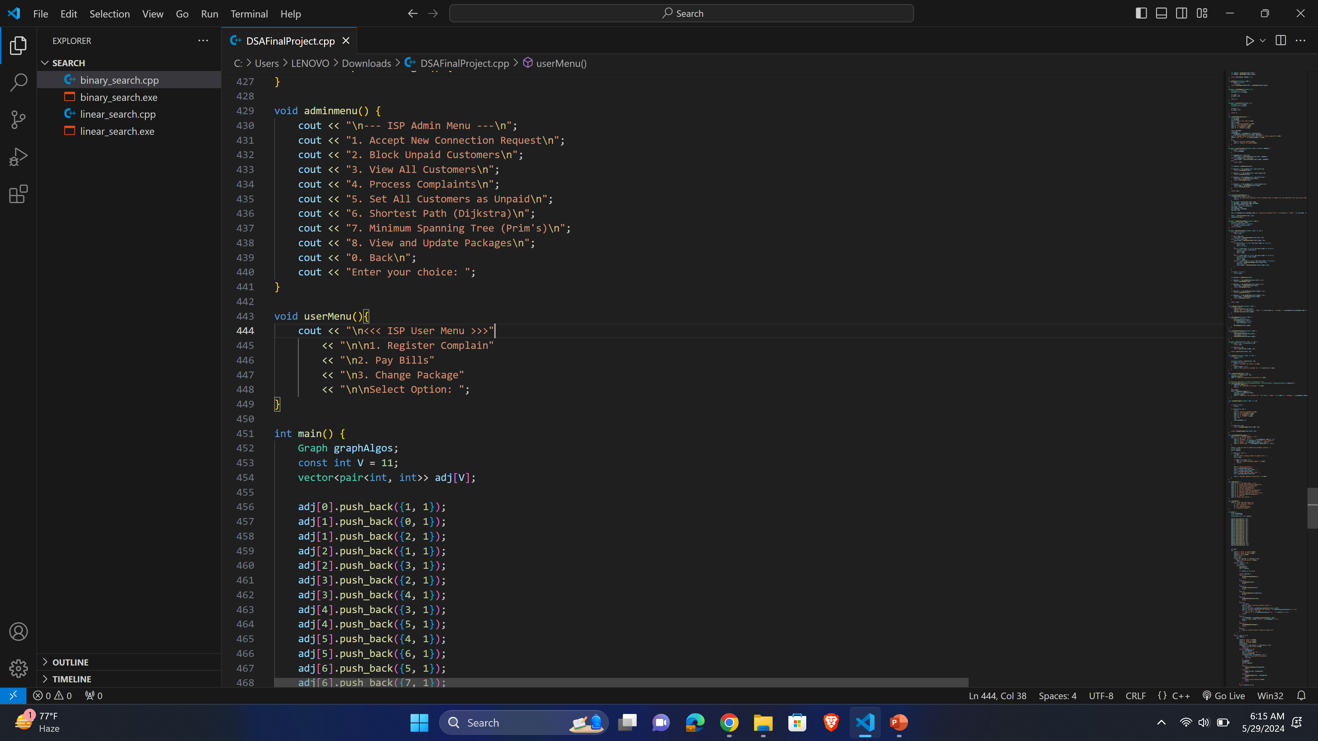
Function Overview
Admin Menu

Slide 5
Function Overview
User Menu

Slide 6
Admin Menu Functions
Accept New Connection Request:
Allows the admin to process and approve new customer connection requests.
Block Unpaid Customers:
Blocks customers who have not paid their bills.
View All Customers:
Displays a list of all customers in the system.
Process Complaints:
Handles and resolves complaints registered by customers.

Slide 7
Admin Menu Functions
Set All Customers as Unpaid:
Resets the payment status of all customers to unpaid.
Shortest Path (Dijkstra):
Uses Dijkstra's algorithm to find the shortest path in the network.
Minimum Spanning Tree (Prim's):
Uses Prim's algorithm to find the minimum spanning tree of the network.
View and Update Packages:
Allows the admin to view and update the service packages available to customers.

Slide 8
User Menu Functions
Register Complain:
Enables users to register complaints about the service.
Pay Bills:
Allows users to pay their outstanding bills.
Change Package:
Enables users to change their current service package.

Slide 9
Data Structures
Priority Queue: Customers connection requests, complaints
Graphs: Network representation, To find MST and shortest path from Source Node(Dijkstra)
AVL TREE: Customer data stored in AVL for efficient searching and retrieval.

Slide 10
Dijkstra's Algorithm
Finds the shortest path between nodes in a graph
Useful for network optimization and troubleshooting

Slide 11
Prim's Algorithm
Finds the minimum spanning tree of a graph
Ensures all nodes are connected with the minimum total edge weight
Important for efficient network design

